Slide 1

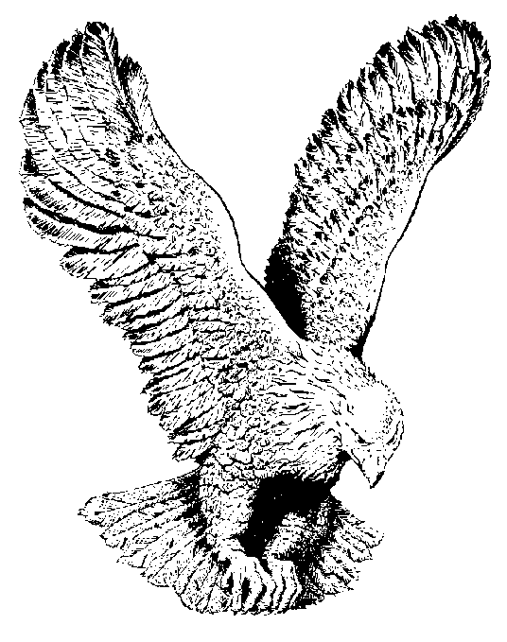
I’M COMING UP
No grave can hold my body down (2x)
For when the trumpet of the Lord shall sound,
And the dead in Christ shall rise,
No grave can hold my body down.

